Slide 1
My sql, postgres and sql server
Made by : oussama beddiaf

Slide 2
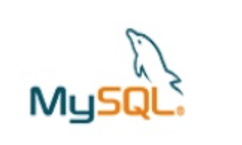

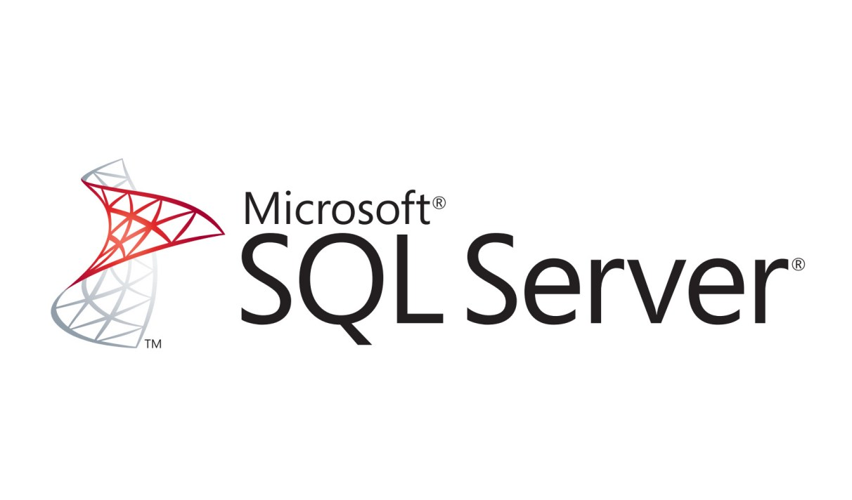
Sound bite
The most popular open source database.
’the web data base‘
The worlds most advanced database.
‘the open source oracle’
SQL server sound bite.

Slide 3
Development priorities (historically)
Postgres:
Data integrity.
Security.
Reliability.
Standards.
DB Features.
Performance.
Ease-of-use.
Programmer features.

Slide 4
Development priorities (historically)
MySql:
Ease-of-use.
Performance.
Programmer features.
Reliability.
Db features.
Data integrity.
Security.
Standards.

Slide 5
Development priorities (historically)
Sql server:
data management.
Performance.
Data integrity.
Ease-of-use.
Reliability.
Db features. Security.
Standards.
Programmer features.

Slide 6
Most common uses
MySql:
Web sites.
CRM.
Logging.
OEM applivations.
Telecom (cluster).
Network tools.
Data Warehouse.

Slide 7
Most common uses
Postgres:
ERP.
Data Warehouse.
Geographic.
Websites.
OEM applications.
Network tools.
CRM.

Slide 8
Most common uses
Sql Server:
Websites.
Data Warehouse.
OEM applications.
Network tools.
Network tools.

Slide 9
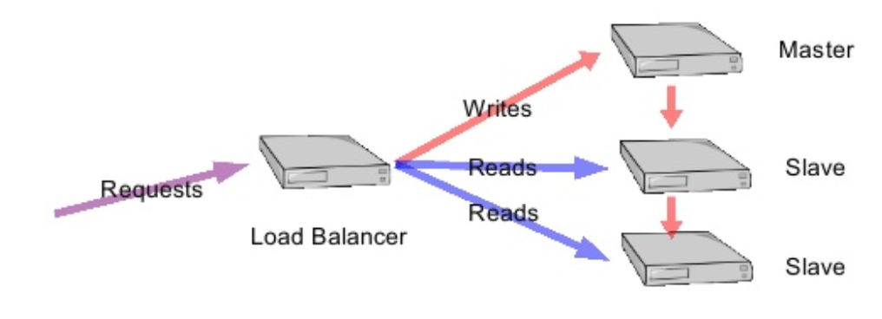
Features : MySql
Pluggable "Storage Engines" allow MySQL to behave like a variety of different databases.
Excellent drivers for all languages.
MySQL Proxy.
3rd Party Support:
Most open source web projects open to MySql.
Hundreds of vendors support MySql.
MySqL scale out.
Used by google, yahoo.

Slide 10
Features : MySql
Easy to set up.
Easy to administrate.
Easy replication: very simple master-slave&multimaster replication.

Slide 11
Features : Postgres
Migeateability:
Automatic migration from Informix – Informix is 50% PostgreSQL.
Easy replication: very simple master-slave&multimaster replication.
Relatively easy migration from Oracle.
Closest to proprietary enterprise DBs.

Slide 12
Features : Postgres
Security
"... by default, PostgreSQL isthe most security-awaredatabase available ..." Database Hackers Handbook(based on a comparison of PostgreSQL, MySQL, Oracle, DB2 and SQL Server).
Authentication:
multiple methods: login, SSL, Kerberos, more.
host-based authentication
Logging :
log output is highly configurable and supports user auditing.
Permissions model:
SQL ROLES supported, including nested roles.
multiple settable permissions on all database objects.
Clean code.

Slide 13
Features : Postgres
Transaction support:
"Bulletproof" ACID thanks to MVCC.
Transactional DDL :
apply schema changes in a transaction.
great for change management . Permissions model:
Savepoints.

Slide 14
Features : Postgres
BI/DW Features :
Large database management features.
Powerful query planner&executor.
Data mining features.

Slide 15
Features : Postgres
Procedural Languages :
Use the language you prefer, inside the database: – SQL – Java – PL/pgSQL – shell – C – R – C++ – PHP – Perl – Ruby – Python – Tcl –PSM –Lua.

Slide 16
Features : sql server
Intelligence accross all your data with big data clusters:
Break down data silos.
Manage both structured and unstructured data.
AI across all your data.

Slide 17
Features : sql server
Choice of language and platform:
Run SQL Server anywhere : Use SQL Server with Windows and Linux containers.
Industry-leading performance:
# 1 in performance: Get record-breaking performance on Windows and Linux. SQL Server consistently leads across the TPC-E OLTP workload, TPC-H data warehousing workload, and real-world application performance benchmarks.
Intelligent database capabilities.
One of most secured data platform:
Fewest vulnerabilities for nine years.
Built-in security and compliance: Use built-in features for data classification, data protection, and monitoring and alerts. SQL Server 2019 monitors, identifies, and provides alerts on suspicious activity—even identifying and remediating security gaps and misconfigurations.
Always encrypted data enclaves.

Slide 18
Features : sql server
SQL Server on Azure.

Slide 19
Features : sql server
SQL Server on Azure.

